Slide 1



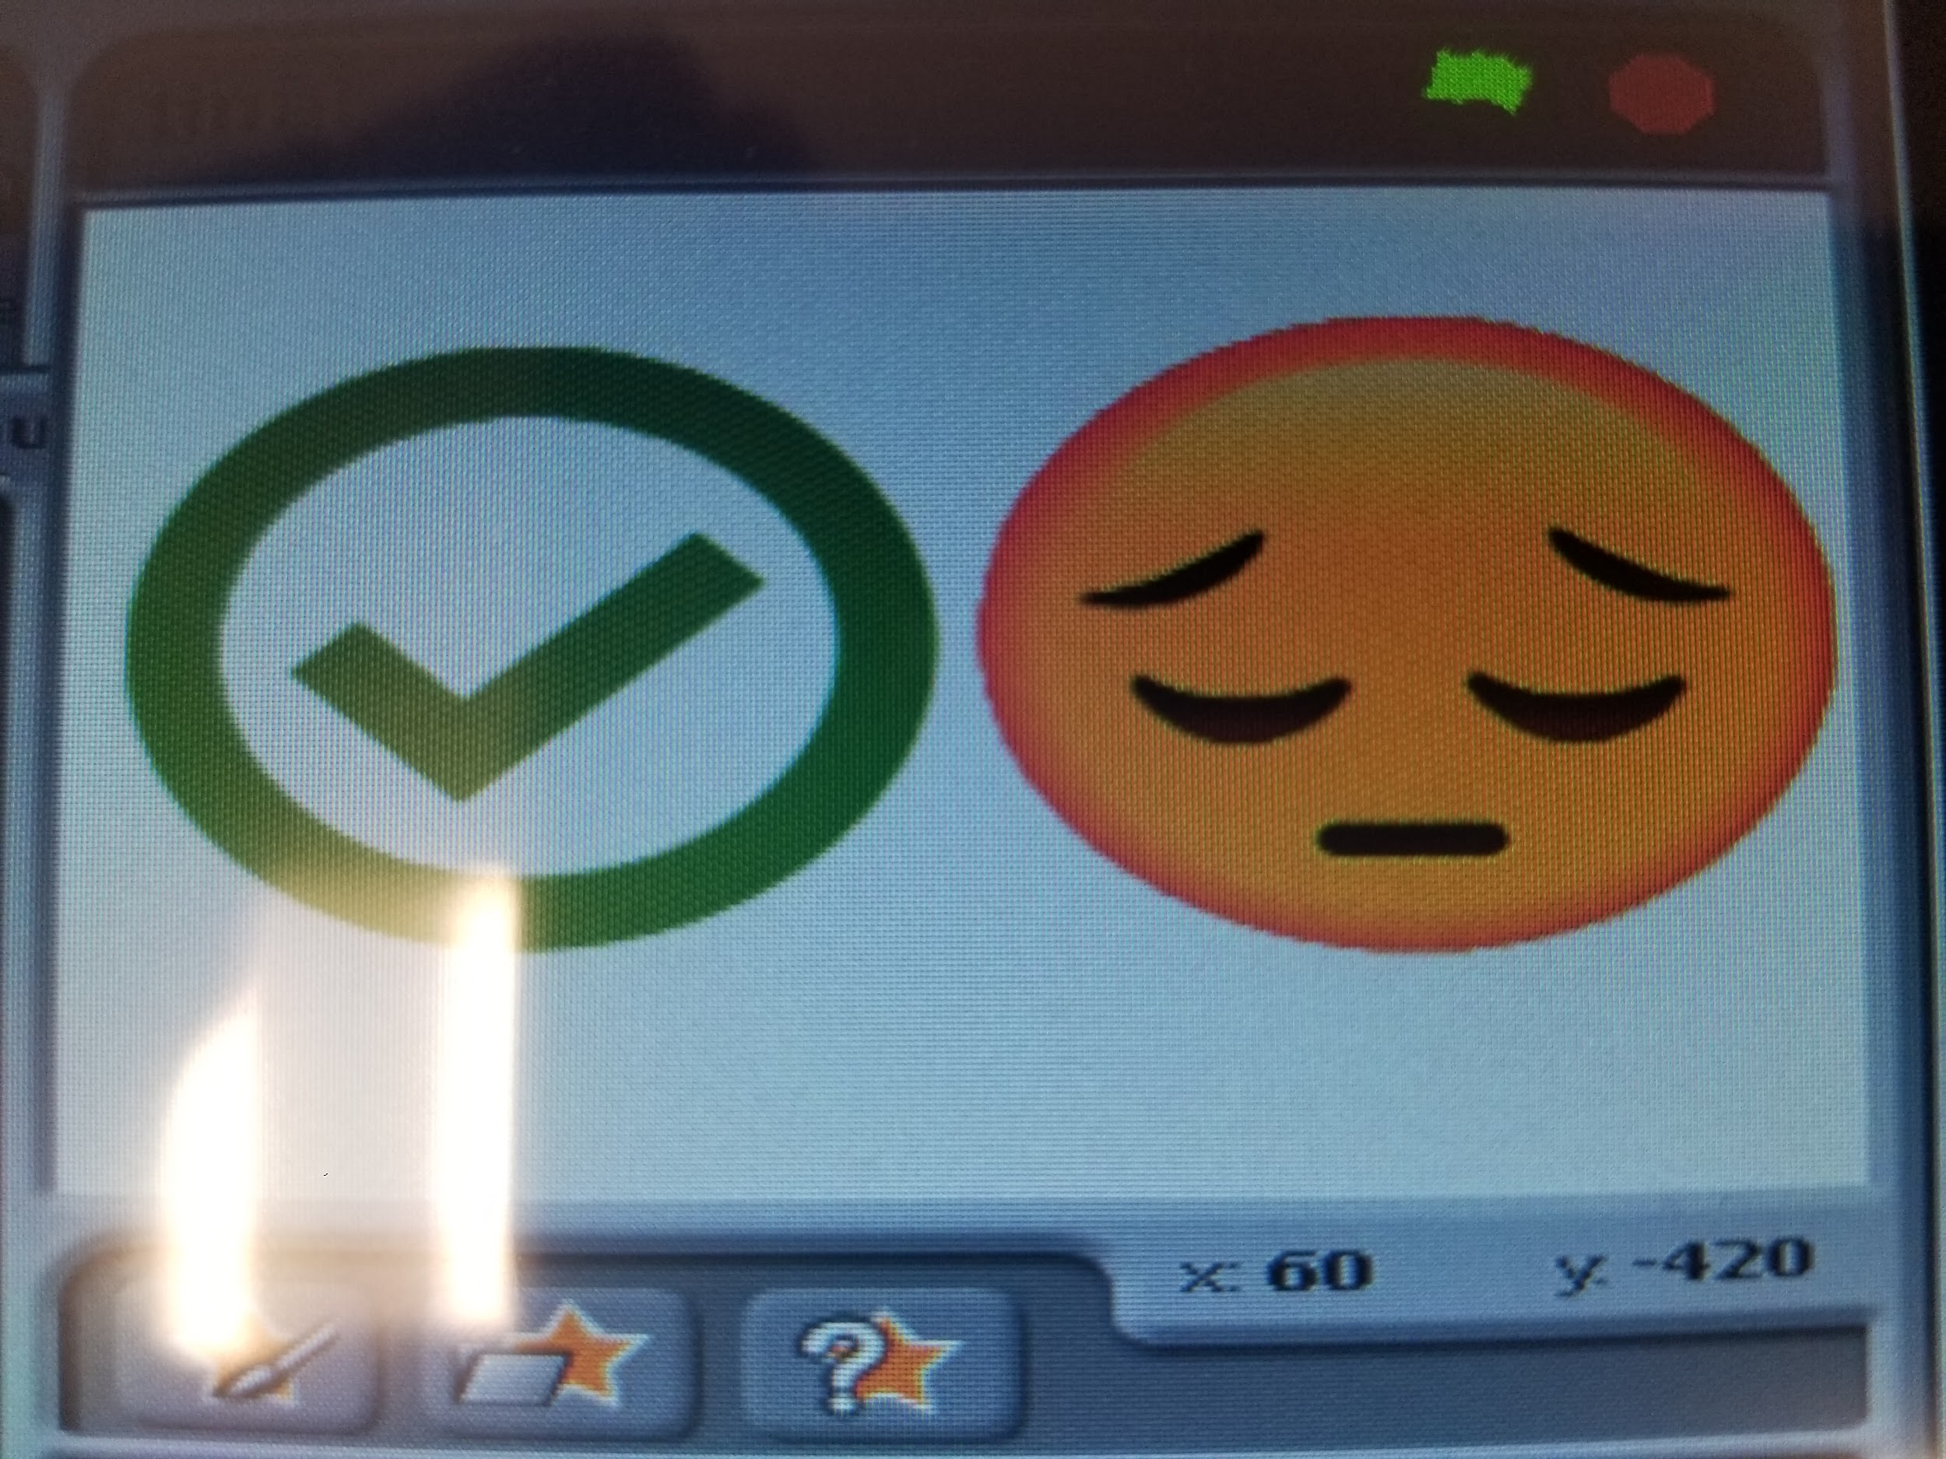
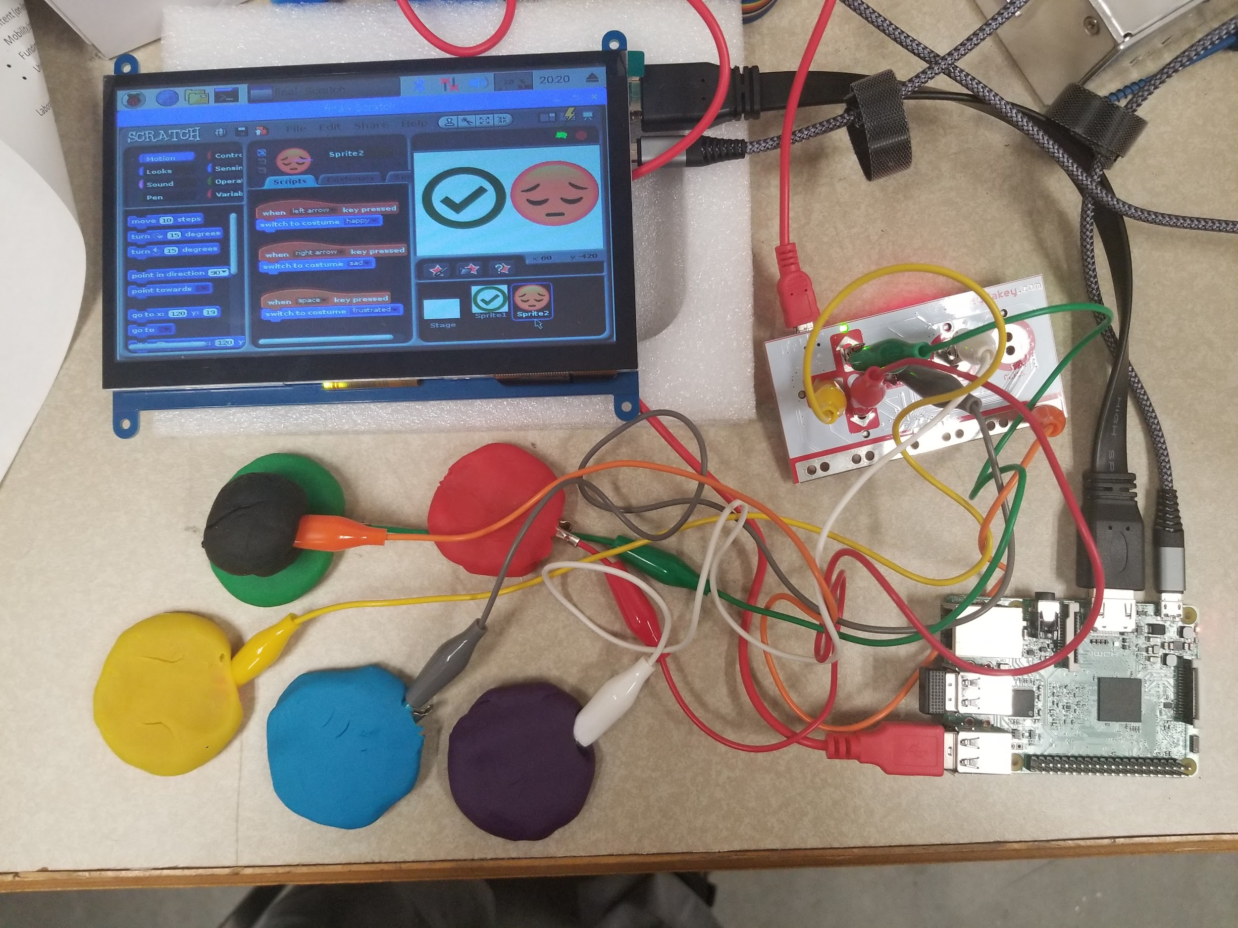
Adaptive Toy Engineering
Makey Makey Classroom Display
Ethan Daily
Mercer University - School of Engineering, Macon, GA
Abstract
The Software
Sometimes children with disabilities have trouble expressing answers to their teachers in the classroom. They also may have trouble expressing how they are feeling at the moment. By implementing a portable screen along with a Makey Makey using Play-Doh as its buttons this display is a portable and disabled friendly interactive display.
The Makey Makey is natively compatible with Scratch a simple block coding IDE. This makes it very easy to change and implement new features for each of the Makey Makey connections. The software itself consists of multiple if statements running in a loop checking each of the Play-Doh buttons. Upon a button being pressed the software either shows Yes/No or changes the emotional state between happy, confused, and angry.
Display
Answering and emotion are separate
The Hardware
The main hardware consists of a Raspberry Pi 3, a Makey Makey, an LCD screen, and a 3D printed housing. The addition of a portable power supply is recommended to allow for portability. The hardware is all mounted in the chassis and 6 alligator clips are fed out to be attached to the Play-Doh buttons.
Fully Setup
Application
The system shown without housing
This device has the possibility to greatly help students and teachers understand each other faster and more effectively. Due to the limit of the Makey Makey only being conductivity this device could easily be modified and have all kinds of other things such as fruit for buttons. This makes the device easily adaptable for many children, who may not enjoy Play-Doh.
Acknowledgements
Thanks to my group members Eric Via and Megan Delmonico who helped design and build this piece of equipment.
Mercer University — Spring 2019 — Macon, GA

